Slide 1
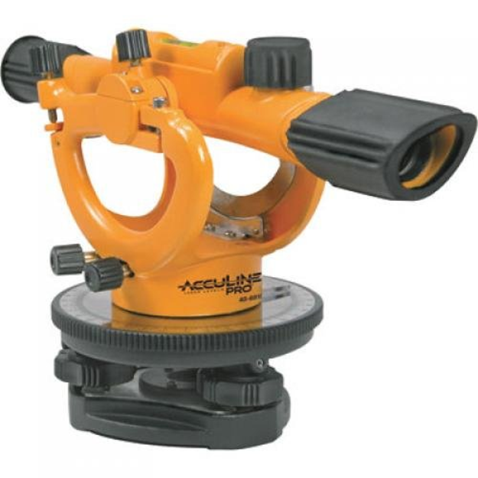
Builder's Level
The Builder’s Level – an inexpensive and versatile instrument used by a field engineer. In addition to leveling operations, A Builder’s Level can be utilized to turn angles in order to layout a building.
A telescope instrument used to check level of forms or field grades. Builders' levels are designed to be used for short distances. Farm or dumpy levels are similar to builder's levels, but have more powerful telescopes. Farm levels are used for longer distances. Both instruments are leveled manually using adjusting screws. An "auto" level requires less manual leveling and has only three leveling screws.

Slide 2
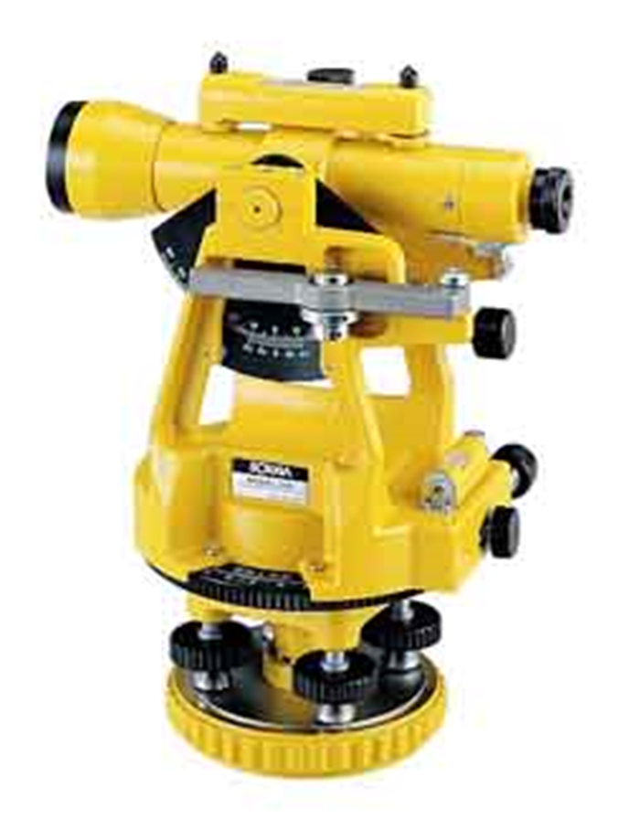
Transit
The Transit – the primary function of a transit is angle measurement but it can be utilized for leveling because of the bubble on the scope.

Slide 3
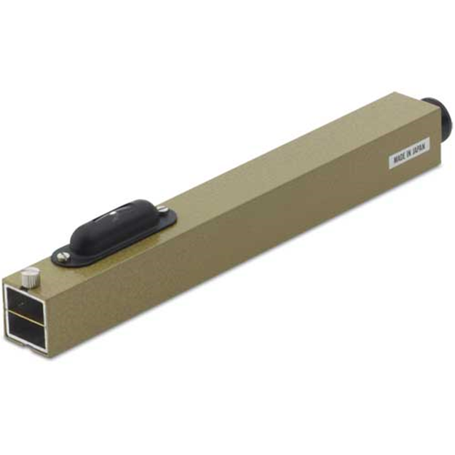
Hand Level (Sight Level)
Hand Level – also called a sight level. Utilized to determine horizontal line, where to set a leveling instrument in relation to the rod and elevations for cut and fill stakes.
The hand level is held in the hand thus providing little accuracy.

Slide 4
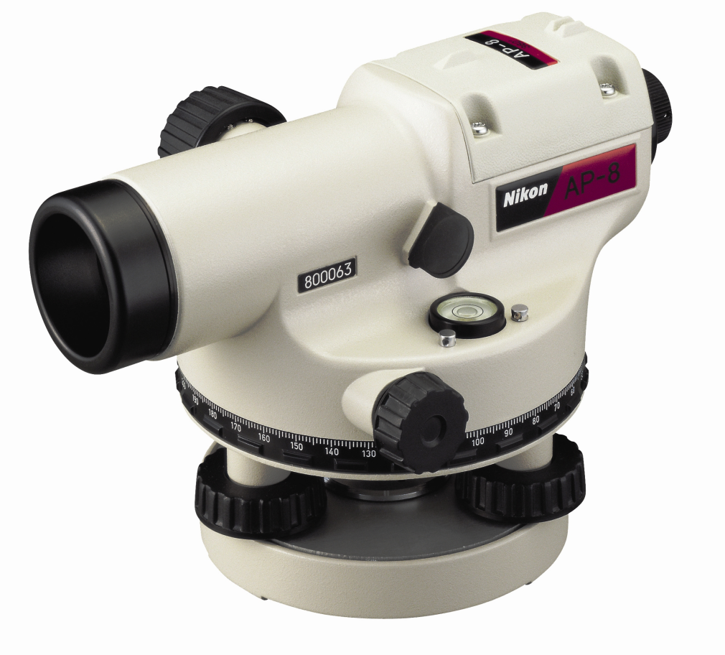
Automatic Level
Automatic Level – now the predominate optical leveling instrument. Must be manually leveled in order for the compensator to work.

Slide 5
Chapter 7
Leveling Instruments
Level Rods – come in all shapes and sizes. They are made of wood, fiberglass and metal. There are one, two, three, four and six piece rods. Four and six piece rods are generally fiberglass construction and telescopic. They can be square, round or oval shaped. Vary in length from 10 ft. to 30 ft. (telescopic).

Slide 6
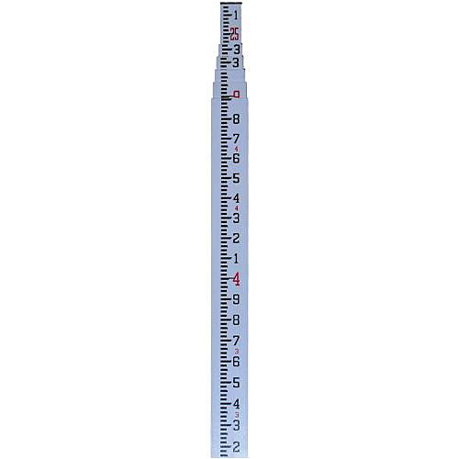
Telescopic Rod

Slide 7
Chapter 7
Leveling Instruments
Level rods can be graduated in feet, inches and fractions; feet, tenths and hundredths or meters and centimeters.
Foot marks on level rods are marked in red for visibility and to distinguish them from other numbers. “Raise for Red” is a term when the instrument person can not see the foot graduation.

Slide 8
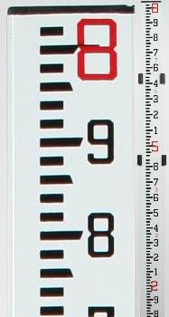

Slide 9
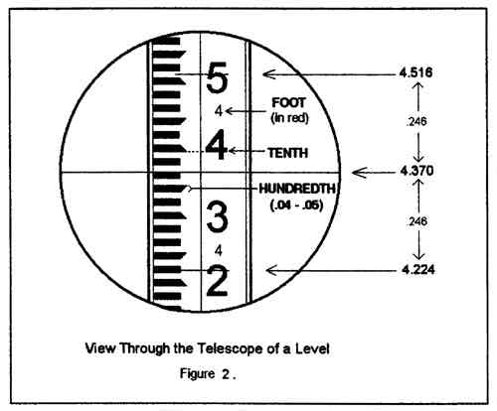

Slide 10
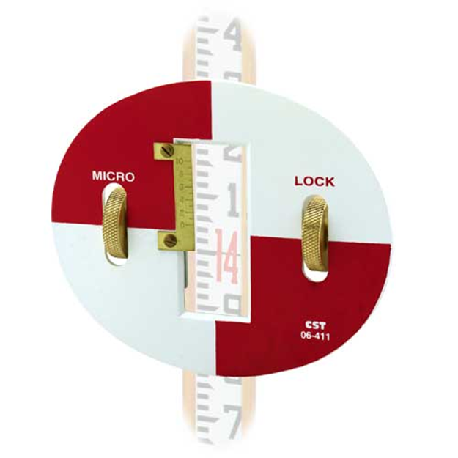
Rod Target
Rod Target – helps the visibility in locating the level rod. A vernier on the target can help obtain a reading to the nearest thousandth of a foot.
Used with the surveyor’s rod to allow readings at a greater distance.

Slide 11
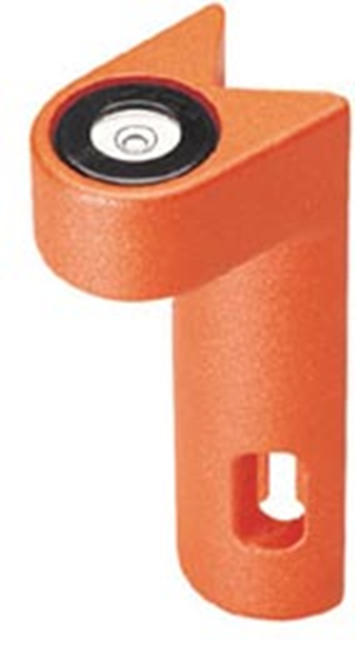
Rod Level
Rod Level – is a device that helps keep the level rod plumb. They are held along the edge of the rod while the level rod is moved until the bubble is centered.

Slide 12
Chapter 7
Setting Up
Set up at the correct height. Levels don’t have to be set up over a point. Make sure the horizontal line of sight intersects with the level rod.
Set up wide and solid. Make sure the tripod has a solid set up.
Set up horizontally. The closer to level you can get the tripod head the easier and quicker it is to level the instrument.

Slide 13
Chapter 7
Setting Up
Level the instrument utilizing the bubble.
Carry the level horizontally to avoid damaging the compensator.

Slide 14
Chapter 7
Rod Use
Check the bottom of rod for any accumulated dirt or mud. Even a small amount can throw an elevation off by a few hundredths. If you have to go back and re-shoot your last half dozen elevation shots, besides being embarrassing, this can by time consuming and add expense.

Slide 15
Chapter 7
Rod Use
Extend the rod – when extending a telescoping rod be careful not to miss a section. Telescoping rod can be 25 ft. to 30 ft. long and have up to six sections. Also make sure each section is fully extended. Even on a two section rod the sections may not slide or fully extend.

Slide 16
Chapter 7
Rod Use
Plumb or Wave the Rod – If a rod level isn’t available, moving the rod forward and backward in front of you will allow the instrument person to read several readings on the rod. The lowest reading occurs when the rod is plumb.

Slide 17
Chapter 7
Rod Use
Turning Point Pin – If a solid point or surface is not available for a Turning Point; a plumb bob, rail road spike or a piece of reinforcing steel can driven into the ground and used as a turning point.

Slide 18

Chapter 7
Accuracy Standards
Balance the back sight and foresight distances to equal out any errors.

Slide 19
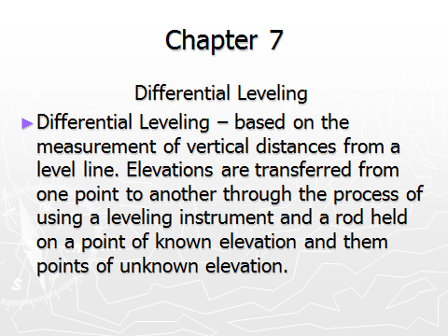

Slide 20
Chapter 7
Differential Leveling
Elevation is the vertical distance above a zero datum.
Leveling datum is generally based on mean sea level (MSL).
The National Geodetic Survey has information about MSL bench marks.

Slide 21
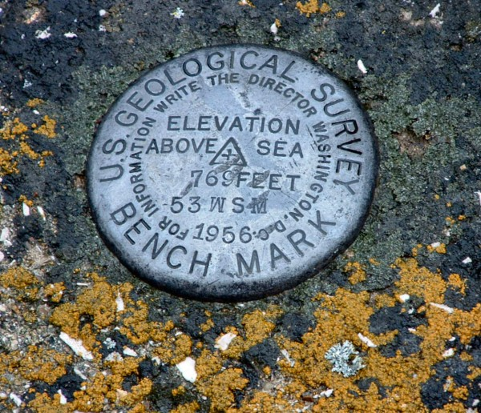

Slide 22
Chapter 7
Differential Leveling
If a construction site doesn’t have access to MSL monument, an elevation can be assumed. Such as 100.00 , 500.00 or 1000.00.
Bench Mark – is a permanent solid point of known elevation. Bench mark can be concrete monument with a brass disk in the middle, iron stake driven into the ground, a railroad spike driven into a tree or the top of a fire hydrant.

Slide 23
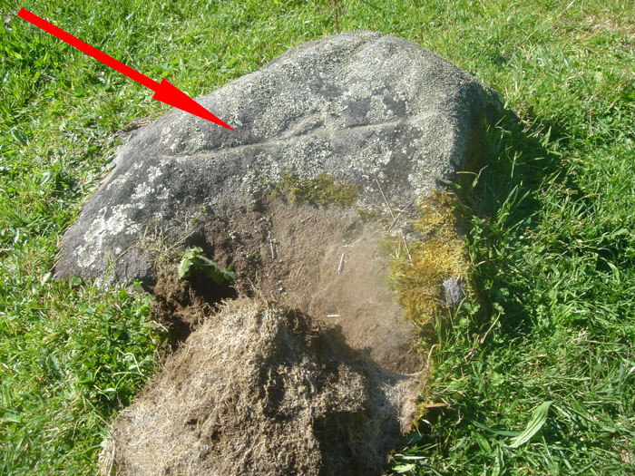

Slide 24
Basic Rules of Differential Leveling
Balance length of BS and FS (300’ max)
Make sure gun is level
Give complete description of BM’s and TBM’s
Have rod rocked or use rod level
Make sure turning points are solid

Slide 25
Chapter 7
Differential Leveling
Back Site (BS) – is a reading on a rod where a rod held on an elevation that is known.
Height of Instrument (HI) – is the elevation of the line of sight of the instrument. This height of instrument is computed by adding the back site to a know elevation. HI = BS + Elevation.
Foresight (FS) – a reading on a rod held on a point whose elevation is unknown.

Slide 26
Chapter 7
Differential Leveling
Turning Point – is a point used in differential leveling on which to temporarily transfer the elevation from the Height of Instrument (HI). The turning point elevation is computed by subtracting the foresight from the height of the instrument.
TP = HI – FS.

Slide 27
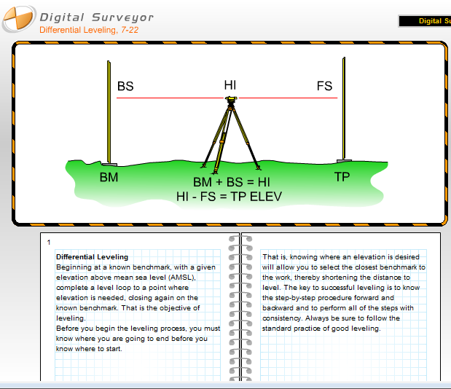

Slide 28
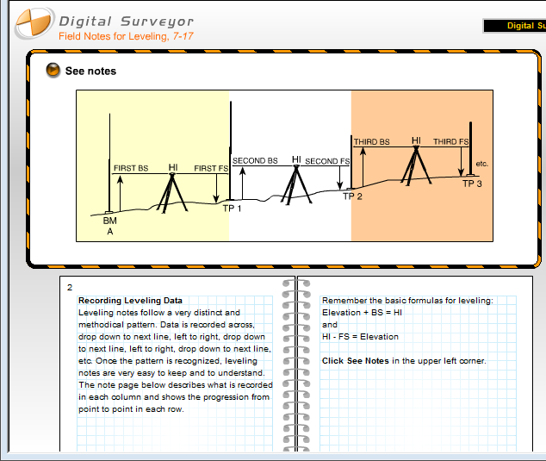

Slide 29
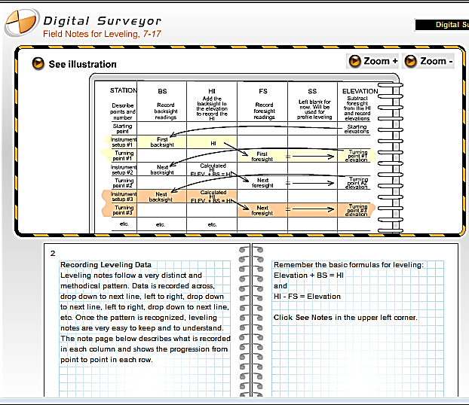

Slide 30
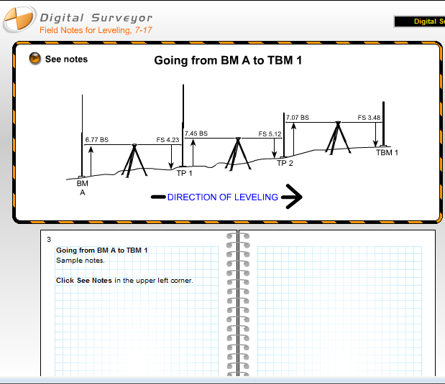

Slide 31
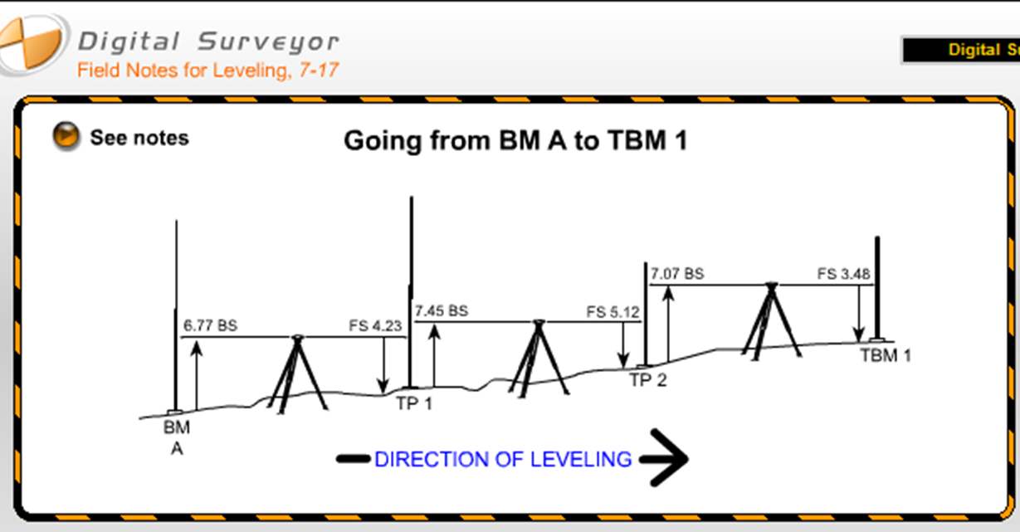
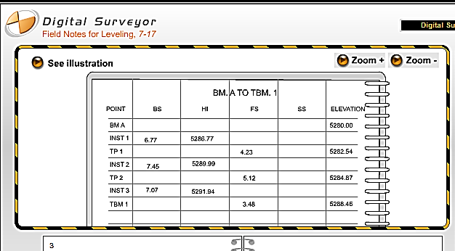

Slide 32
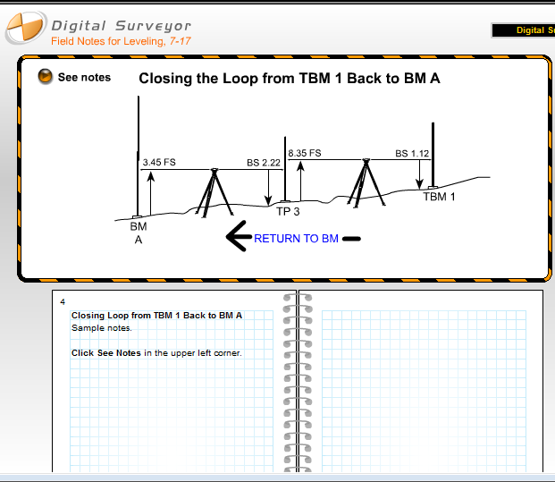

Slide 33
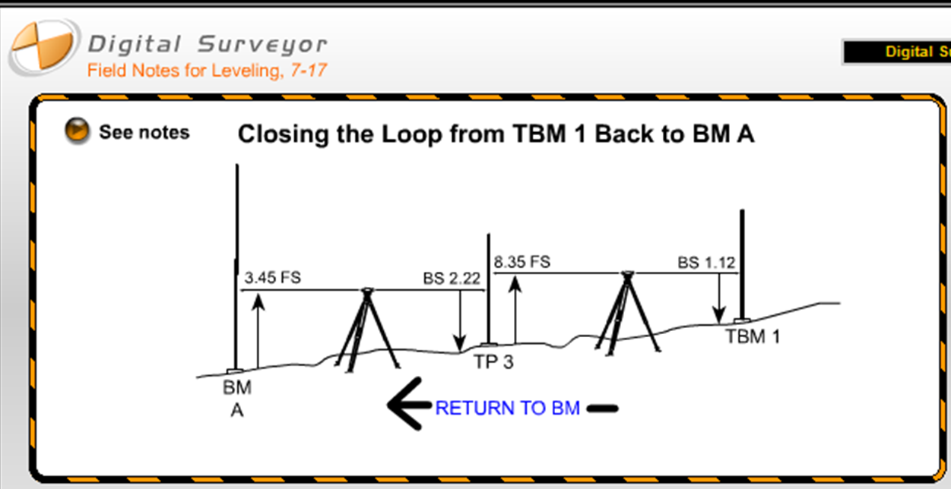
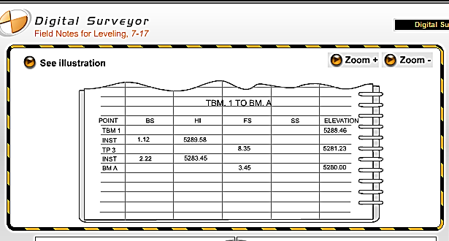

Slide 34
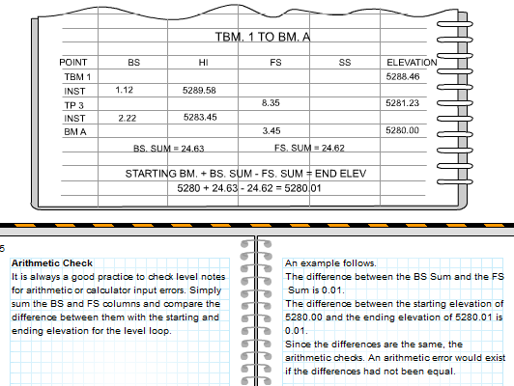

Slide 35
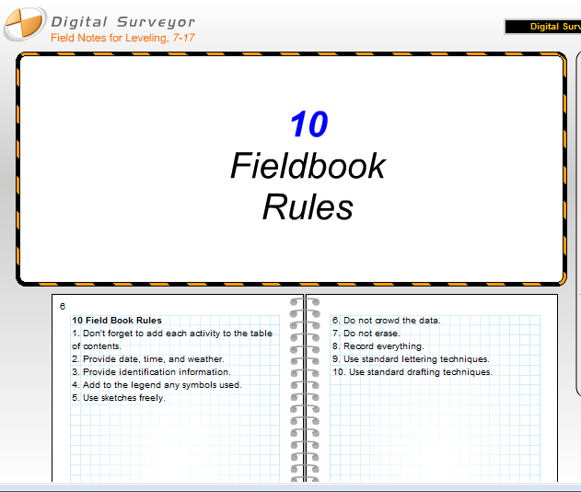


Slide 36
Chapter 7
Profile Leveling
Profile Leveling - is the process where elevation shots are taken in order to get picture and general slope of an area of ground.
Profile elevations are utilized in the geometric design of roadways, sewers and bridges.

Slide 37
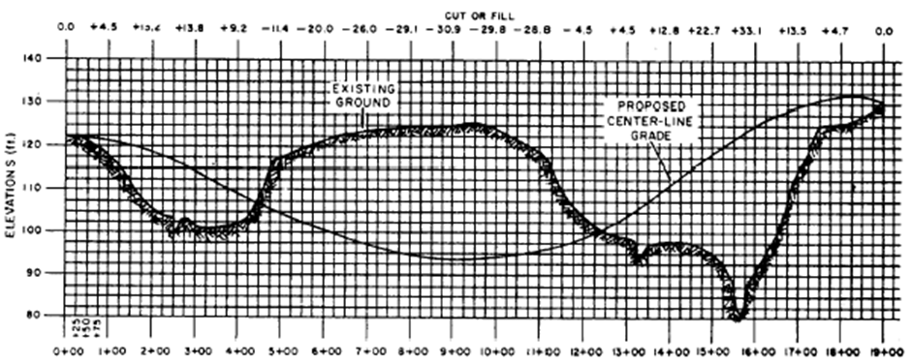
Chapter 7

Slide 38
Chapter 7
Procedure for Profile Leveling
Establish profile points on a line with a chain, EDM or theodolite.
Profile points should be taken at regular intervals like 25 ft., 50 ft. or 100 ft. depending on the length or what’s required for the profile.
Profile points should be marked with a stake or hub.
Information regarding stationing and elevation shot should be marked on a lath adjacent the stake or hub.

Slide 39
Chapter 7
Procedure for Profile Leveling
Locate a bench mark and tie into the end of the leveling loop.
Back sight and foresight distances should be approximately equal distance. Maximum sight distance should be 150 ft. in order to reduce errors.
Read and record to the nearest 0.01 ft. (hundredth) the back sight to the bench mark.
Determine the height of instrument elevation. HI = BS + Bench Mark Elevation

Slide 40
Chapter 7
Procedure for Profile Leveling
Advance the rod person to the pre-determined profile points.
Read and record each profile point to nearest 0.01 ft. (hundredth).
Repeat this process until a turning point is needed.

Slide 41
Chapter 7
Procedure for Profile Leveling
If a turning point is needed the rod person should select a turning point that is approximately equal distance from the instrument as the back sight.
Read and record the foresight to nearest 0.01 ft. (hundredth).
Calculate the elevation of the turning point. TP = HI – FS.

Slide 42
Chapter 7
Procedure for Profile Leveling
After determining the elevation of the turning point, repeat Steps 3 and 4 until all the profile elevations have been read.
After completion of the profile elevations close the loop by having the rod person go back to the original bench mark or another bench mark of known elevation.
Read the rod and subtract the reading from the height of instrument.
This should give the elevation of the bench mark.

Slide 43
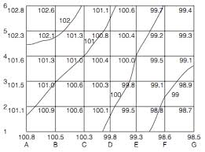
Chapter 7
Grid Leveling
Grid leveling is performed in order to calculate earthwork excavation or embankment quantities.
It is a redundant activity that is performed over and over. Elevations in a grid may be shot several times.
Grid leveling is an extension of differential leveling.
Calculations are the same as differential leveling.

Slide 44
Chapter 7
Grid Leveling
Numerous foresight shots are taken in a grid pattern.
Note taking is similar to differential leveling.

Slide 45
Procedure for Grid Leveling
Procedure for Grid Leveling
Use one side of the grid as a base line. Mark intervals (25 ft., 50 ft., 100 ft. etc.) on the base line.
After marking intervals on the base line determine a perpendicular line on one end of the base line with a right angle prism or the 3/4/5 triangle method.

Slide 46
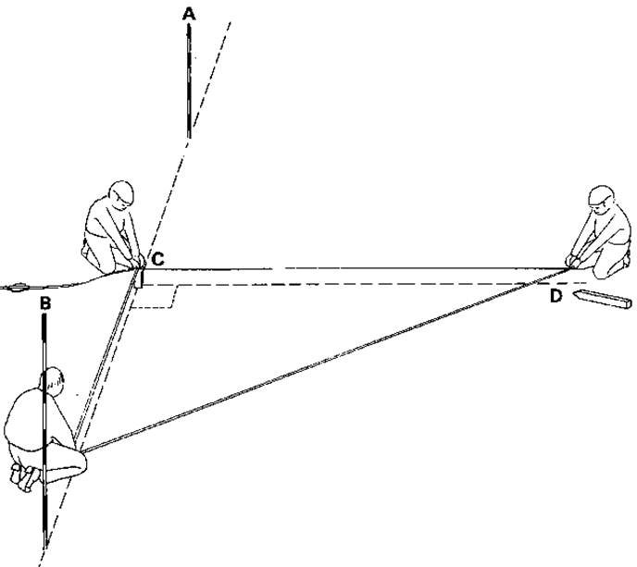
Procedure for Grid Leveling
Procedure for Grid Leveling
In order to utilize to 3/4/5 method. Measure 30 ft. along the perpendicular line and mark it.
Then measure 40 ft. along the base line and mark it.
These two line form the legs of a right triangle.
Measure between the marks, it should measure 50 ft.

Slide 47
Chapter 7
Procedure for Grid Leveling
After establishing the perpendicular line, mark intervals along it.
Locate a bench mark and tie into the end of the leveling loop. Back sight and foresight distances should be approximately equal distance. Maximum sight distance should be 150 ft. in order to reduce errors.

Slide 48
Chapter 7
Procedure for Grid Leveling
Read and record to the nearest 0.01 ft. (hundredth) the back sight to the bench mark.
Determine the height of instrument elevation.
Advance the rod person to the pre-determined grid points.
Read and record each profile point to nearest 0.1 ft. (tenth).
Repeat this process until a turning point is needed.

